Slide 1
Code::Blocks
if statement

Slide 2
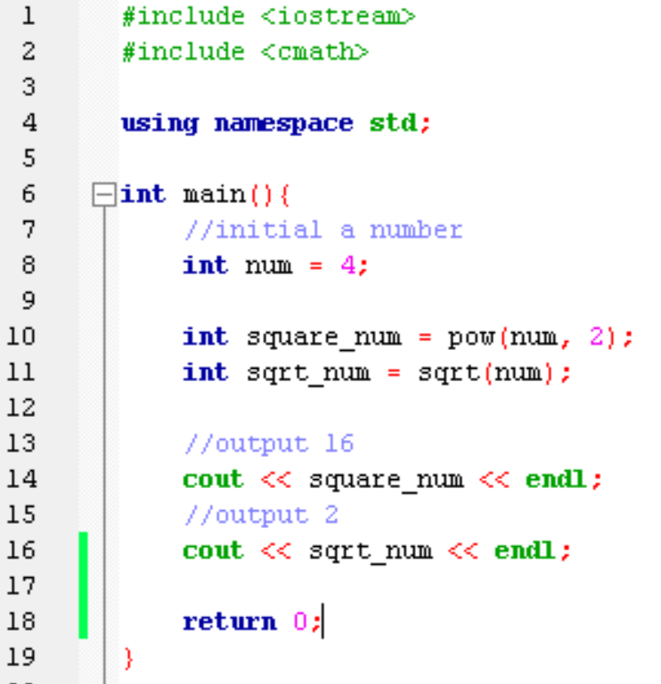
cmath library
Some math can calculated by cmath library
Example:
pow function will calculate number to the power.
For example, this line will calculate num to the power of two
sqrt function will calculate the square root of the number

Slide 3
Logical operators
Operator | Meaning | example
&& | And | (i > 0) && (i < 10)
|| | Or | (i < 0) && (i > 10)
! | Not | !(i > 0)
And : True if both conditions are true
Or : True if at least one condition is true
Not : True if condition is false

Slide 4
Truth Table
&& | Expression1 | Expression2 | Expression1 && Expression 2
 | True | True | True
 | True | False | False
 | False | True | False
 | False | False | False
|| | Expression1 | Expression2 | Expression1 || Expression 2
 | True | True | True
 | True | False | True
 | False | True | True
 | False | False | False
! | Expression1 | !Expression1
 | True | False
 | False | True

Slide 5
if statement
condition
True
Syntax:
if(condition){
actions to do when the condition is true..
}
statements
False
Use curly bracket
Example:
No ; is needed
if(score >= 60)
{
cout << “You pass!” << endl;
}

Slide 6
If…else…
No
Score >= 60
Yes
Example:
if(score >= 60)
{
cout << “You pass!” << endl;
}
else
{
cout << “You fail!” << endl;
}
“Fail”
“Pass”

Slide 7
If…else if…
Example:
if(score >= 80)
{
cout << “Great!” << endl;
}
else if(score >= 60 && score < 80)
{
cout << “Good!” << endl;
}
else{
cout << “Fail!” << endl;
}

Slide 8
Practice(1/2)
User input a score, range is in 0 to 100, if score is out of range, print “invalid input”, otherwise, print the string according to the form
Score | String
80-100 | You get A
70-79 | You get B
60-69 | You get C
50-59 | You get D
Below 49 | You Fail

Slide 9
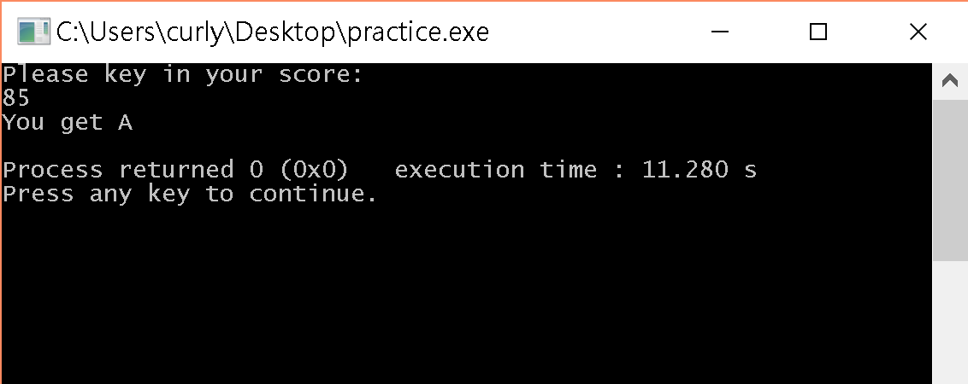
Practice(2/2)
Display the hint string same as the example below.

